Slide 1

Working with Assistants Part 16: Code Interpreter

Slide 2
What’s Covered in This Session
Understanding Code Interpreter
Passing Files and Generating Text Results
Formatting the Markdown Output
Passing Files to a Thread
Getting Output From Multiple Files
Streaming Text & Images

Slide 3
Understanding & Enabling Code Interpreter
Writing, Running, and Analyzing!
Notes:
https://platform.openai.com/docs/assistants/tools/code-interpreter/code-interpreter-beta

Slide 4
Assistant Tools
File Search
Code Interpreter
Function
Notes:
https://platform.openai.com/docs/api-reference/assistants/createAssistant#assistants-createassistant-tools

Slide 5
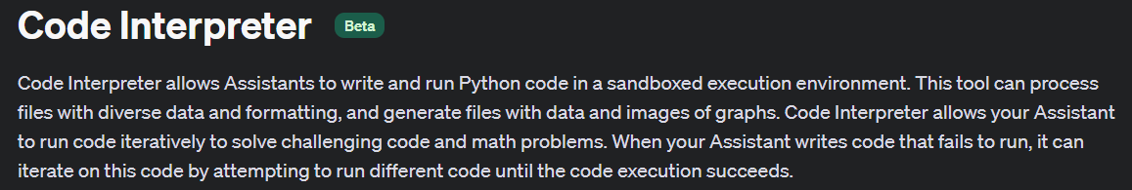
Notes:
https://platform.openai.com/docs/assistants/tools/code-interpreter/code-interpreter-beta

Slide 6
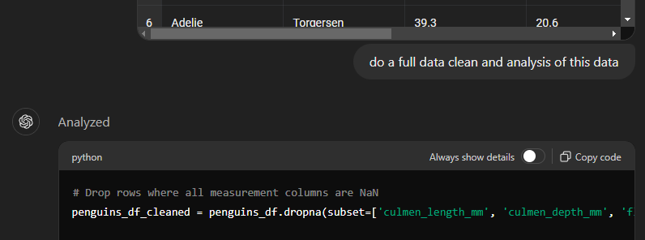
Demo: Code Interpreter in ChatGPT

Slide 7
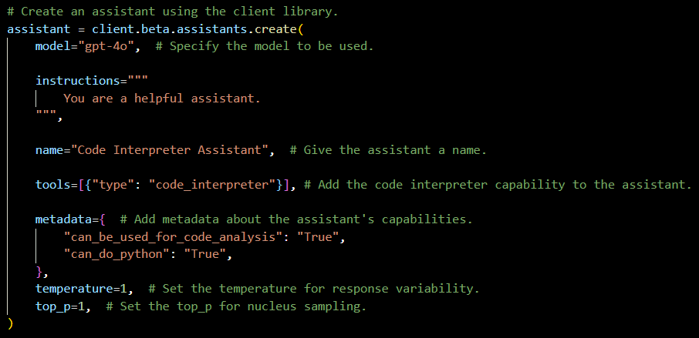
Demo: Enabling Code Interpreter

Slide 8



Notes:
https://www.youtube.com/channel/UC35ZpwldGw7ZJ5R-2sLijzw

Slide 9
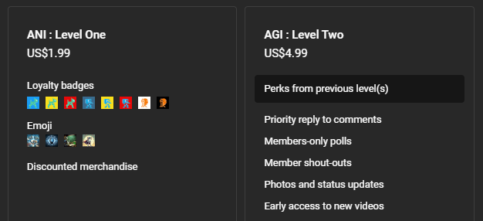

Membership has its privileges
Notes:
https://www.youtube.com/channel/UC35ZpwldGw7ZJ5R-2sLijzw/join

Slide 10
Passing Files & Getting Text Results
Giving Code Interpreter Data
Notes:
https://platform.openai.com/docs/assistants/tools/code-interpreter/passing-files-to-code-interpreter

Slide 11

File Passing Possible Locations
THREAD
ASSISTANT
RUN
MESSAGE
Notes:
https://platform.openai.com/docs/assistants/tools/code-interpreter/passing-files-to-code-interpreter

Slide 12
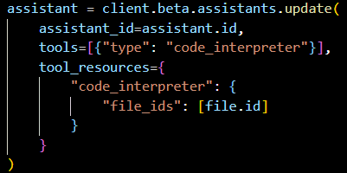
Demo: Passing a File to the Assistant

Slide 13
Formatting the Output
Time to Work with Markdown
Notes:
https://www.markdownguide.org/getting-started/

Slide 14
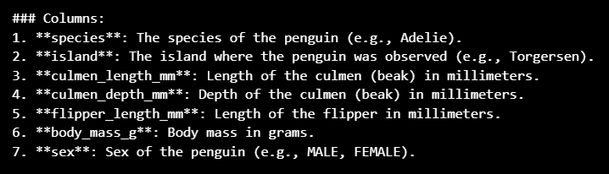
Before

Slide 15
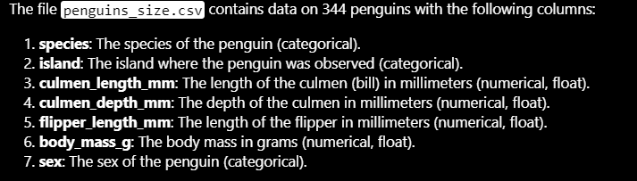
After

Slide 16
Demo: Formatting Output (static)
# Process each annotation to replace the text with indexed references and gather citations.
for index, annotation in enumerate(annotations):
# Replace the annotated text with an indexed reference in the message content.
message_content.value = message_content.value.replace(annotation.text, f"[{index}]")
# Check if there is a file citation in the annotation.
file_citation = getattr(annotation, "file_citation", None)
if file_citation:
# Retrieve the cited file's details using its file ID.
cited_file = client.files.retrieve(file_citation.file_id)
# Append the citation with the indexed reference and file name to the citations list.
citations.append(f"[{index}] {cited_file.filename}")
# Display the processed message content with indexed references using Markdown.
display(Markdown(message_content.value))

Slide 17
Demo: Formatting Output (streaming)
class EventHandler(AssistantEventHandler):
"""Custom event handler for processing assistant events."""
def __init__(self):
super().__init__()
self.results = [] # Initialize an empty list to store the results
@override
def on_text_delta(self, delta, snapshot):
"""Handle the event when there is a text delta (partial text)."""
# Append the delta value (partial text) to the results list
self.results.append(delta.value)
# Call the method to update the Jupyter Notebook cell
self.update_output()
def update_output(self):
"""Update the Jupyter Notebook cell with the current markdown content."""
# Clear the current output in the Jupyter Notebook cell
clear_output(wait=True)
# Join all the text fragments stored in results to form the complete markdown content
markdown_content = "".join(self.results)
# Display the markdown content in the Jupyter Notebook cell
display(Markdown(markdown_content))

Slide 18
Passing Files to a Thread
The “Other” Way to Pass Files

Slide 19
File Passing Possible Locations
THREAD
ASSISTANT
RUN
MESSAGE
Notes:
https://platform.openai.com/docs/assistants/tools/code-interpreter/passing-files-to-code-interpreter

Slide 20
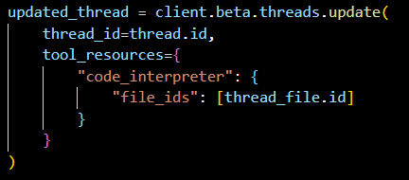
Demo: Passing a File to a Thread

Slide 21
Getting Output From Multiple Files
Why Not Use Both?

Slide 22
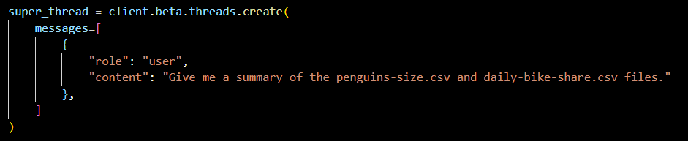
Demo: Getting Results from Assistants and Threads

Slide 23
Text & Images Output
My Kingdom for a UI/UX Person!

Slide 25
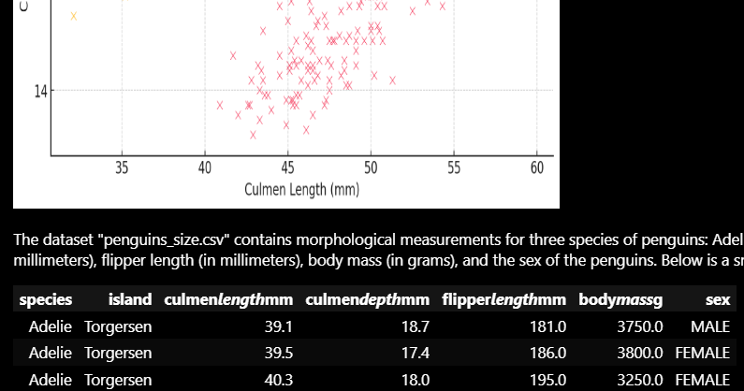
Kind of a Demo: Getting Text & Images

Slide 26


